Slide 1
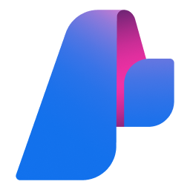
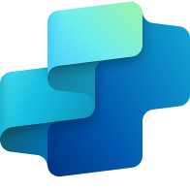
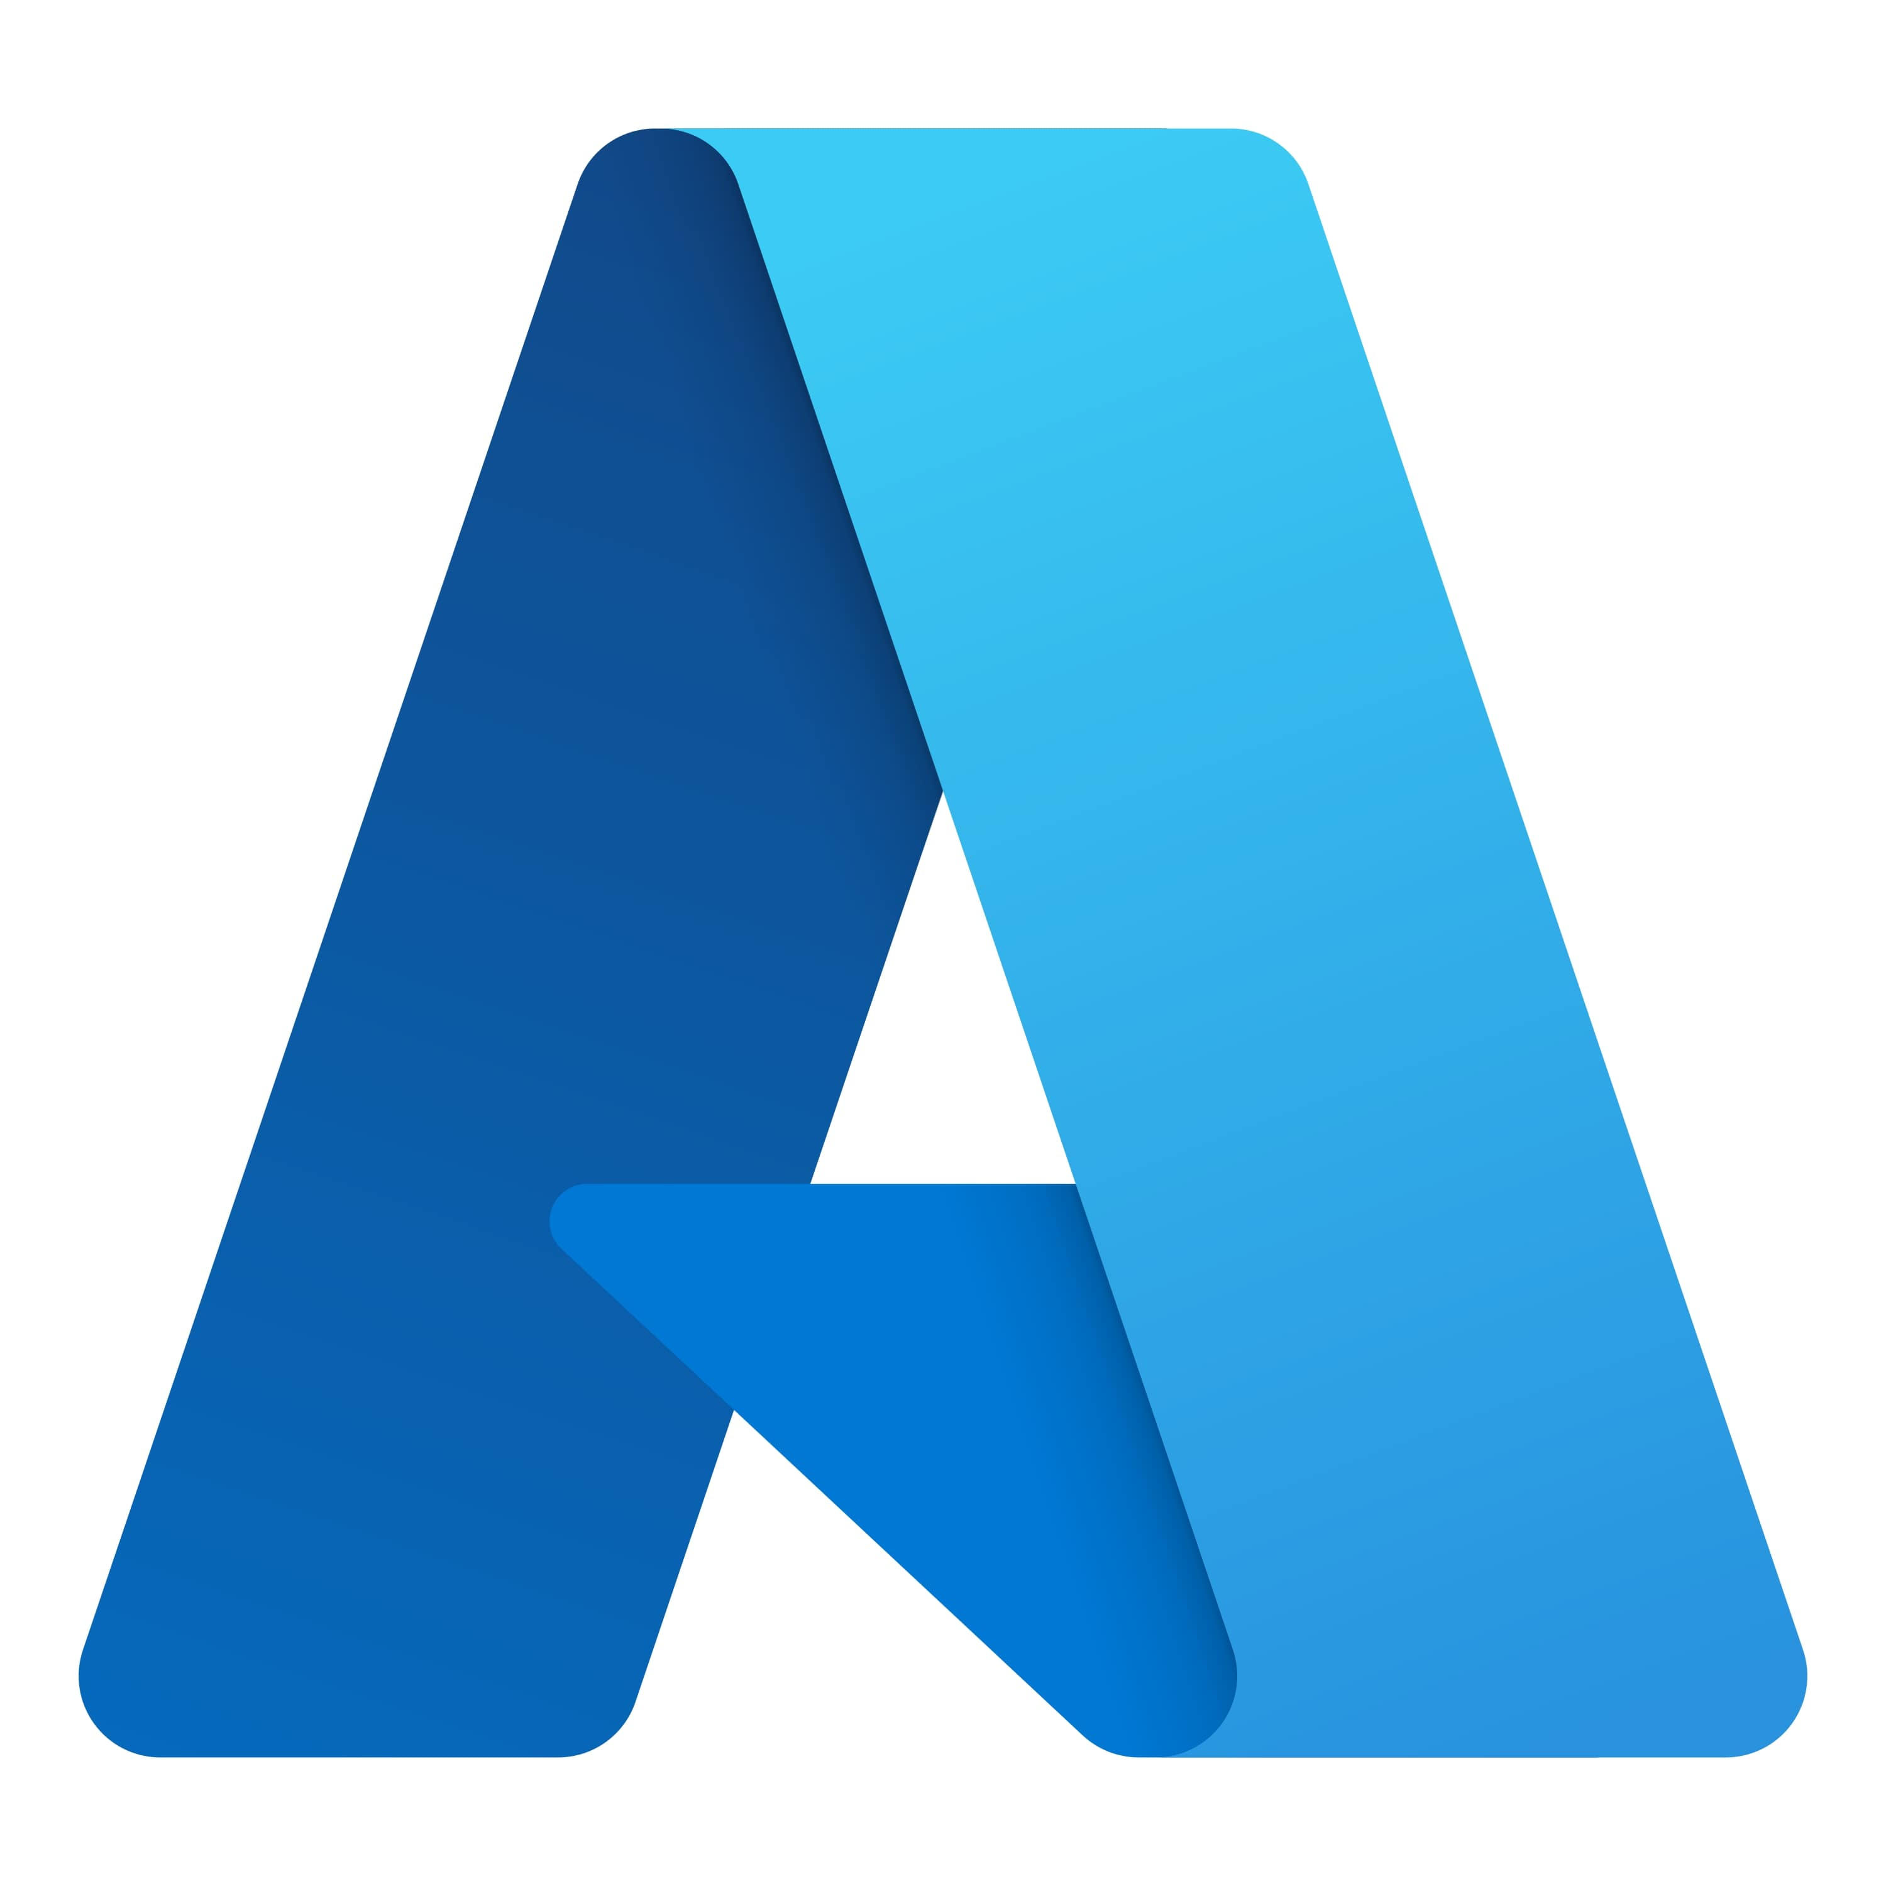
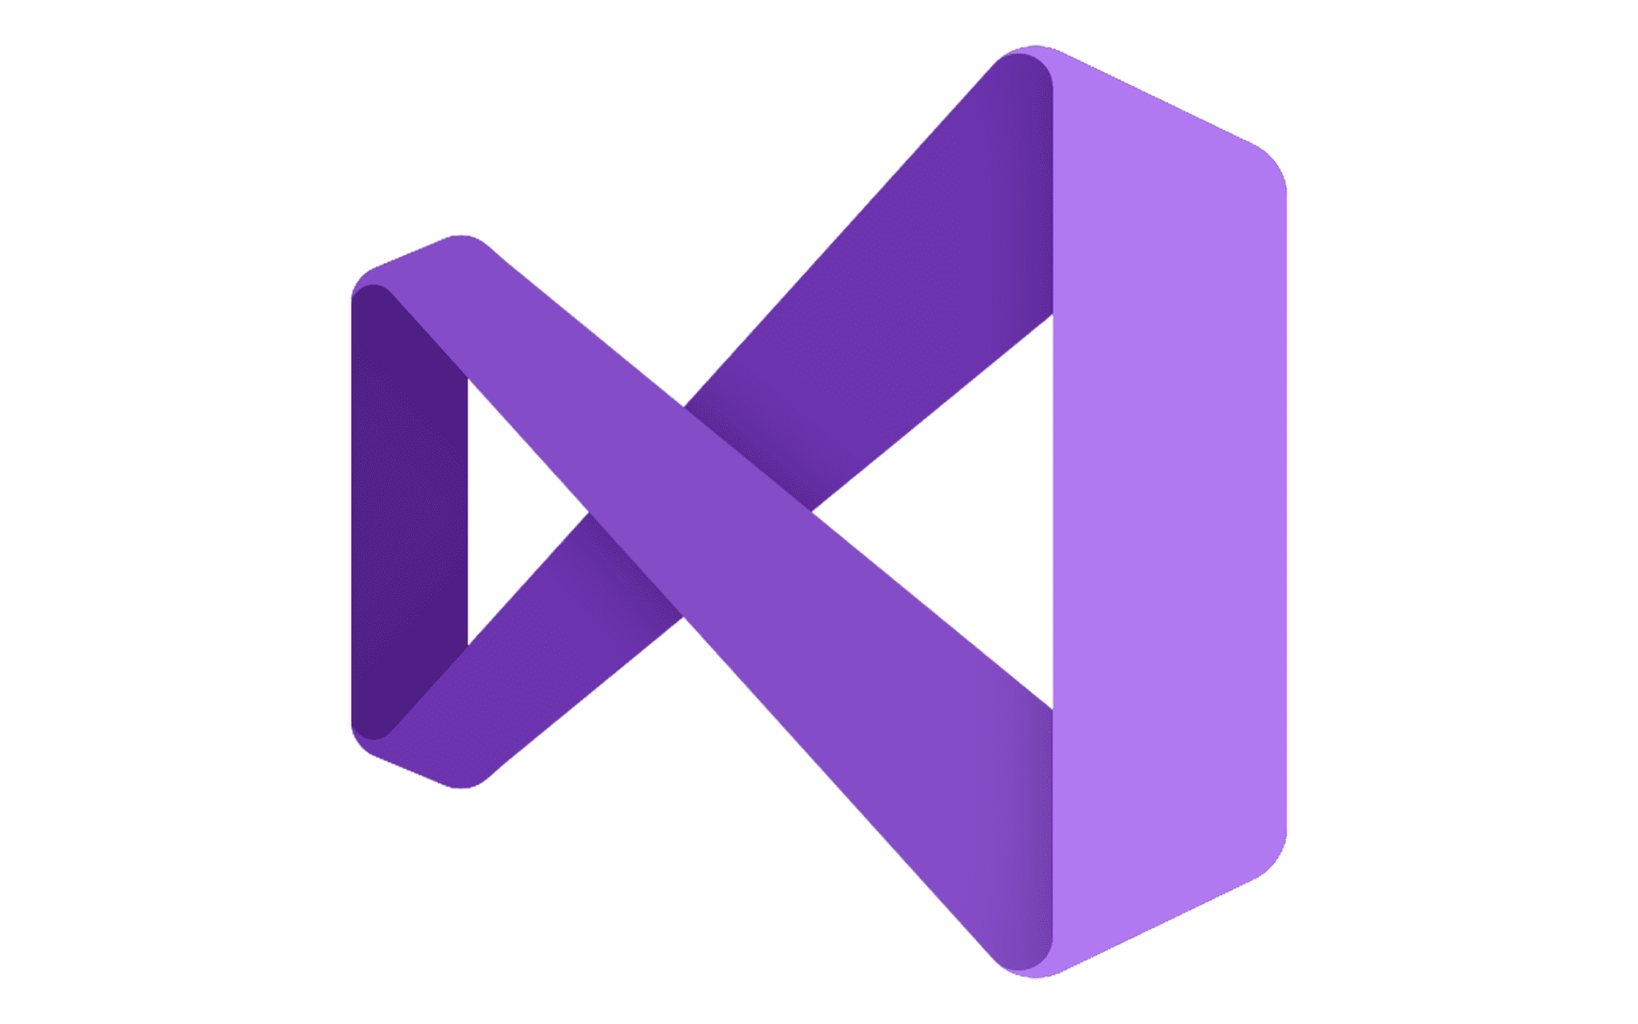







Azure AI Foundry
Copilot Studio
Foundry Models
Cloud
Visual Studio
Azure
Foundry Agent Service
Azure Arc
GitHub
Azure AI
Search
Azure AI
Services
Azure
Machine Learning
Azure AI
Content Safety
Foundry Local
Foundry SDK
Foundry Observability
Edge
Security • Identity • Management
Control
Azure Kubernetes Service
Azure App Service
Azure Container Apps
Azure Functions
Serverless
Notes:
Azure AI Foundry is a flexible, secure platform of services that empowers enterprises, start-ups and software developer companies to create the future of AI. Use developer tools you already know – GitHub, Visual Studio, and Copilot Studio - to build powerful solutions that can optimize call center performance, analyze data, improve product discovery, validate code, automate workflows, and more. Azure AI Foundry brings models, agents, tools, and more into one unified experience. Access services through a developer-friendly portal, unified SDK, and APIs. Ship faster with quick-start templates. Deploy models to run anywhere. Experiment with continuous feedback loops. Scale to deliver agents that optimize workflows with confidence.

Slide 2
Azure AI Foundry
Copilot Studio
Foundry Models
Cloud
Visual Studio
Azure
Foundry Agent Service
Azure Arc
GitHub
Azure AI
Search
Azure AI
Services
Azure
Machine Learning
Azure AI
Content Safety
Foundry Local
Foundry SDK
Foundry Observability
Edge
Security • Identity • Management
Control
Azure Kubernetes Service
Azure App Service
Azure Container Apps
Azure Functions
Serverless
Notes:
Azure AI Foundry is a flexible, secure platform of services that empowers enterprises, start-ups and software developer companies to create the future of AI. Use developer tools you already know – GitHub, Visual Studio, and Copilot Studio - to build powerful solutions that can optimize call center performance, analyze data, improve product discovery, validate code, automate workflows, and more. Azure AI Foundry brings models, agents, tools, and more into one unified experience. Access services through a developer-friendly portal, unified SDK, and APIs. Ship faster with quick-start templates. Deploy models to run anywhere. Experiment with continuous feedback loops. Scale to deliver agents that optimize workflows with confidence.

Slide 3

Call to Action Are you ready to create the future of AI?
Explore Azure AI Foundry: ai.azure.com
Download the SDK: aka.ms/aifoundrysdk
Review documentation: aka.ms/AzureAI
Take the Azure AI Learn Course: aka.ms/learnatbuild
Join our developer community channels:
Chat with us on Discord: aka.ms/ai/discord
Provide feedback on GitHub: aka.ms/azureaifoundry/forum
Read more about what’s new in Azure AI Foundry
aka.ms/Build25/HeroBlog/Foundry

Slide 4
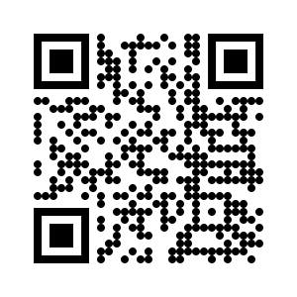
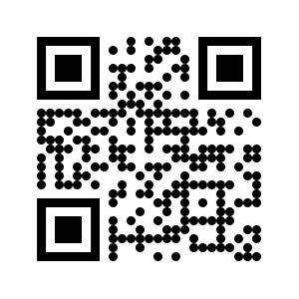
Join
Azure AI Foundry Developer Community
Let's Build the Future of AI Together
Azure AI Foundry Discussions
Azure AI Foundry Discord

Slide 5
Join
Azure AI Foundry Developer Community
aka.ms/foundry/discord
aka.ms/foundry/forum

